Slide 1
Romanization Systems
McCune/Reischauer
Ministry of Education & Culture
Koguryo
Paekche
Koryo
Pusan
Kaya
Choson
Goguryeo
Baekje
Goryeo
Busan
Gaya
Joseon

Slide 2
Korea In East Asia

Slide 3
Cultural Definition
East Asia is that portion of Asia sharing these four characteristics
China Centered Civilization
Use of the Chinese Writing System
Neo-Confucianism
Mahayana Buddhism
So defined, East Asia encompasses China, Taiwan, Japan, the Koreas

Slide 4
Korean Geography
A peninsula (obviously).
Roughly 600 miles long.
About 120 miles wide at its narrowest point.
Roughly the same area as England.

Slide 5
Physical Geography
North mountainous and heavily forested.
South more conducive
to agriculture.
70% of peninsula is mountains creating habitable pockets.
East coast isolated, west coast tidal (like us) leaving limited access to the sea.

Slide 6
Korean Mountains

Slide 7
Korean Rivers
Han
Naktong
Yalu
Tumem

Slide 8
Climate
Lies in the Northern Temperate zone.
Despite being a peninsula, experiences continental climate.
Moderate rainfall.

Slide 9
Two Koreas

Slide 10
No North Korea
Official name of “North Korea”
Democratic People’s Republic of Korea (DPRK)

Slide 11
Ditto The South
Official name of “South Korea”
Republic of Korea
(ROK)

Slide 12
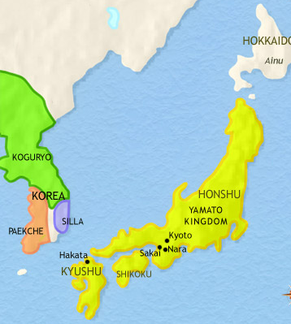
Korea/Japan Cultural Sphere
Clan based societies.
Animistic/shamanistic religious practices.
Strong hereditary principle.
Aristocratic class systems.
Presence of slavery.
Isolated and separate from Chinese civilization.
Remarkably parallel development.

Slide 13
Shamanism

Slide 14
Historic Korea
Old Joseon (Choson)
1500BCE
The Samhan: 0-313
Silla, Baekje, Gaya (Mimana)
The Three Kingdoms: 313-698
Silla
Baekje
Goguryeo

Slide 15
Silla/Parhae (Balhae)

Slide 16
Gyeongju (Silla Capitol)

Slide 17
Bolguksa

Slide 18
Seokguram Grotto

Slide 23
Korea/Japan Cultural Sphere
Clan based societies.
Animistic/shamanistic religious practices.
Strong hereditary principle.
Aristocratic class systems.
Presence of slavery.
Isolated and separate from Chinese civilization.

Slide 24
Late Yamato, 500-710

Slide 26
Korean War
DPRK Invades ROK June 25, 1950
UN Forces enter DPRK Sept. 1950
PRC Forces intervene Nov. 1950
Front stabilizes summer 1951
Armistice halts war July 23, 1953

