Slide 1
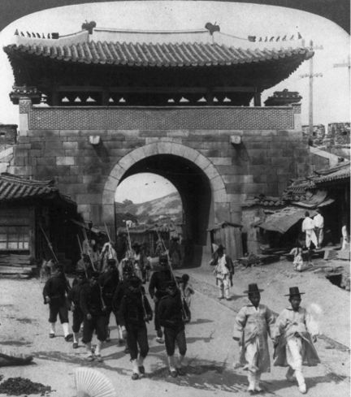
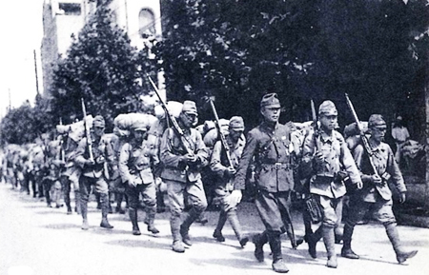
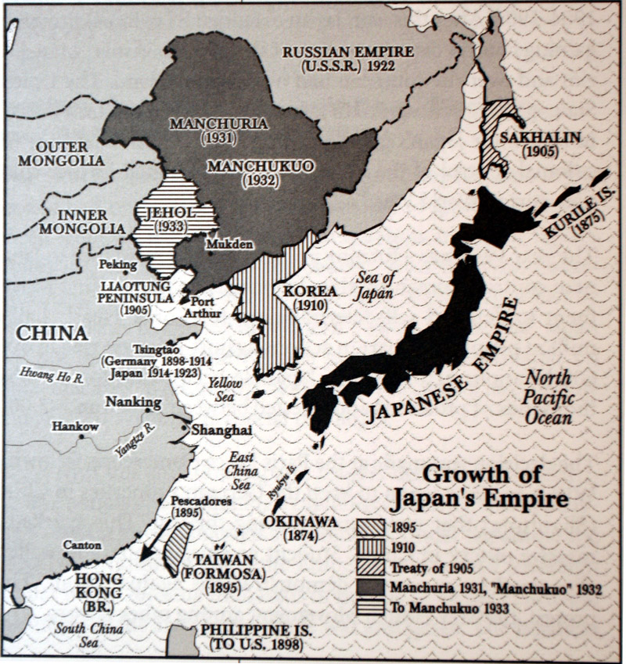
Living Under Japanese Colonial rule in Korea
Lesson two from SPICE:
Colonial Korea in Historical Perspective

Slide 2
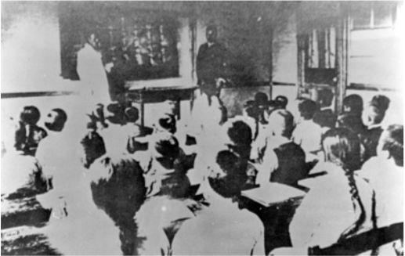
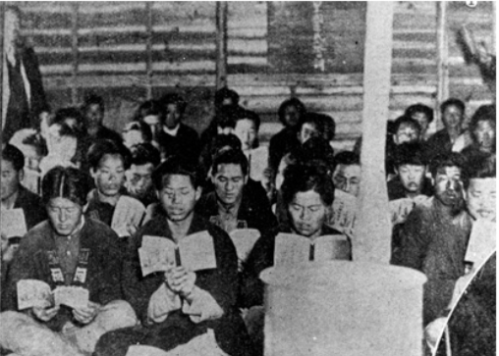
O.P.T.I.C.
A
Use the OPTIC method to analyze ONE of these images.
0 = OVERVIEW: 1or 2 sentences that summarize the image.
P = PARTS: Describe the important details/parts of the picture.
T = TITLE: What does it tell you about the picture? If there isn’t one, make one up.
I = INTERRELATIONSHIPS: How do objects or people relate to each other?
C= CONCLUSION: What is the meaning or message of the image?
B

Slide 3
Bias Analysis
Bias is prejudice in favor of or against one thing, person, or group compared with another, usually in a way considered to be unfair. Therefore, it lacks a neutral point of view and can come in many forms.
Primary sources are inevitably biased to one degree or another. Therefore, it is important to critically examine the validity and usefulness of primary sources when analyzing them.
Bias Analysis
Why did the author create the source?
Was the recorder a neutral party, or did the author have opinions or interests that might have influenced what was recorded?
Did the recorder wish to inform or persuade others? Did the recorder have reasons to be honest or dishonest?

Slide 4
Bias analysis
Time and Place Analysis
Did the recorder have firsthand knowledge of the events discussed? Or, did the recorder report what others saw and heard?
Was the information recorded during the event, immediately after the event, or after some lapse of time? How large was the lapse of time?

Slide 5
Apply your knowledge
Bias Analysis 1. Why did the author create the source? 2. Was the recorder a neutral party, or did the author have opinions or interests that might have influenced what was recorded? 3. Did the recorder wish to inform or persuade others? Did the recorder have reasons to be honest or dishonest?
Time and Place Analysis 1. Did the recorder have firsthand knowledge of the events discussed? Or, did the recorder report what others saw and heard? 2. Was the information recorded during the event, immediately after the event, or after some lapse of time? How large was the lapse of time?

Slide 6
Apply your knowledge
Bias Analysis 1. Why did the author create the source? 2. Was the recorder a neutral party, or did the author have opinions or interests that might have influenced what was recorded? 3. Did the recorder wish to inform or persuade others? Did the recorder have reasons to be honest or dishonest?
Time and Place Analysis 1. Did the recorder have firsthand knowledge of the events discussed? Or, did the recorder report what others saw and heard? 2. Was the information recorded during the event, immediately after the event, or after some lapse of time? How large was the lapse of time?

Slide 7
Primary source analysis and Presentation
You will work in a small group to analyze a variety of primary sources from the period of Japanese colonialism in Korea.
Each person will analyze two sources and share their results with the group.
Next, you will discuss which information and sources you believe should be included in a textbook entry on the history of colonial Korea.
Prepare a visual to present to the class on your topic.
Your visual and presentation should include:
An introduction to the topic you have researched and important information about the topic.
The sources you believe should be included in the textbook
Why you believe the information and sources you have chosen are important for students to know.

Slide 8
Textbook Writing summit
I. Goal: to write and review a textbook entry on the various aspects of colonial life in Korea under Japanese rule
II. Audience: high school students (grades 9–12) in the United States
III. Length: 2–3 pages (12-point font, single-spaced)
IV. Questions to keep in mind:
A. Objectivity: Is there a balance in presenting facts and perspectives? B. Clarity: Is the text clear and easy to understand? Does it provide adequate explanations for complex concepts and content that might be unfamiliar to most students? C. Use of original/primary sources: Are the sources used credible, appropriate, and useful? Do the sources support the narrative and provide meaningful insights? Is there a good balance in the types of sources used (e.g., images, statistics, articles)? D. Organization: Does the text have a logical progression and flow (e.g., topical and chronological order)? Does any part of the content contradict another part? E. Syntax: Is the text free of grammatical errors?

Slide 9
Our textbook…
“But growing Japanese power also presented a threat to its Asian neighbors. In 1910 Japan annexed Korea as a Japanese colony, demonstrating that its power in Asia was growing.”
Human Legacy: Ramirez, Stearns, and Wineburg Page 752

