Slide 1
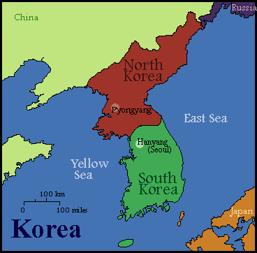
What do you know about Korea?
A Pre-test

Slide 2
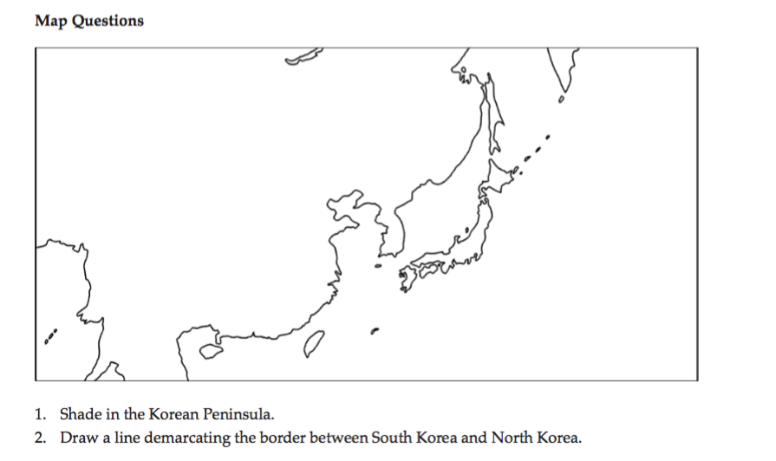
Questions 1 and 2

Slide 3
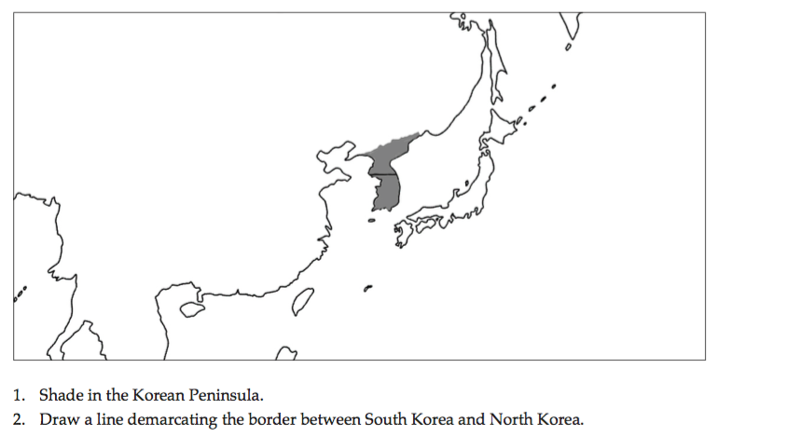
Answers 1 and 2

Slide 4
Question 3

Slide 5
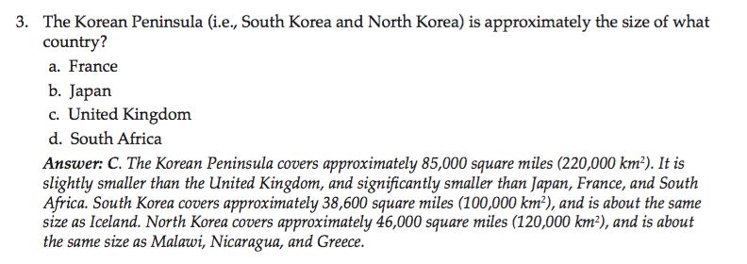
Answers 3 and 4

Slide 6
Questions 4 and 5

Slide 7
Answers 4 and 5

Slide 8
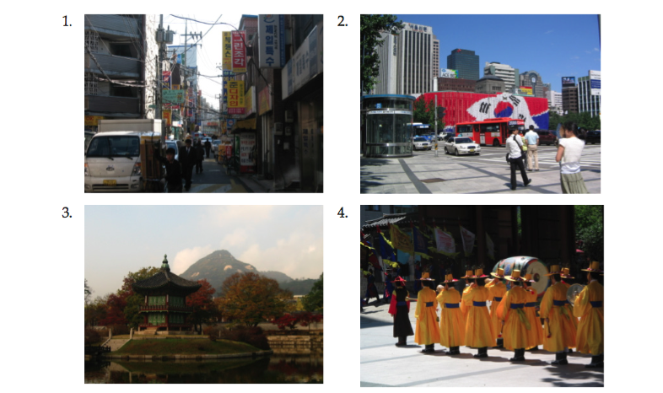
Question 6

Slide 9
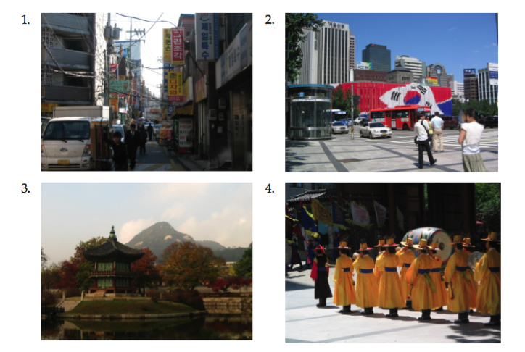
Answers 6: All!

Slide 10
Questions 7 and 8

Slide 11
Answers 7 and 8

